Slide 1
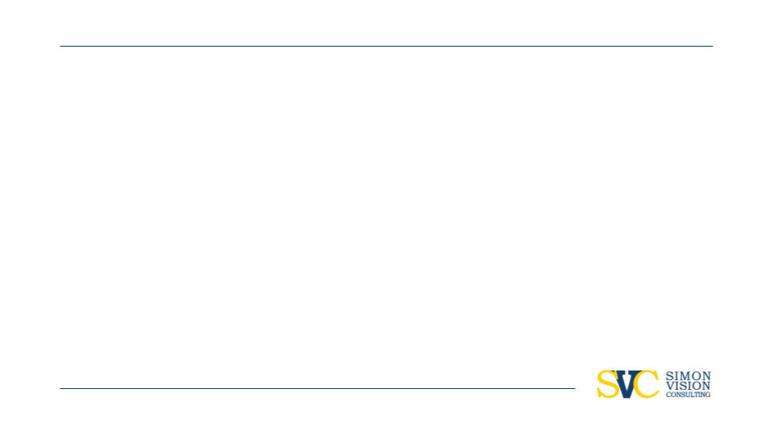

Market Sizing
SW | Customer Personas | Market Scope | TAM | SAM | Market Share
PROJECT MANAGER: Adhithya Rokhith Bhaskar
TEAM: Urvashi Bajpai, Krish Shrimanker, Harshvardhan Tiwary, Abdul Rehman, Drishti Grover
ADD YOUR OWN TEXT HERE;)
ADD YOUR OWN TEXT ADD YOUR OWN TEXT ADD YOUR OWN TEXT ADD YOUR OWN TEXT ADD YOUR OWN TEXT ADD YOUR OWN TEXT ADD YOUR OWN TEXT ADD YOUR OWN TEXT ADD YOUR OWN TEXT ADD YOUR OWN TEXT ADD YOUR OWN TEXT ADD YOUR OWN TEXT ADD YOUR OWN TEXT ADD YOUR OWN TEXT ADD YOUR OWN TEXT ADD YOUR OWN TEXT

Slide 2
Objective & Purpose
Determining the Size of the Market in the US
Evaluating the feasibility of Market Size
ADD YOUR OWN TEXT HERE;)
ADD YOUR OWN TEXT ADD YOUR OWN TEXT ADD YOUR OWN TEXT ADD YOUR OWN TEXT ADD YOUR OWN TEXT ADD YOUR OWN TEXT ADD YOUR OWN TEXT ADD YOUR OWN TEXT ADD YOUR OWN TEXT ADD YOUR OWN TEXT ADD YOUR OWN TEXT ADD YOUR OWN TEXT ADD YOUR OWN TEXT ADD YOUR OWN TEXT ADD YOUR OWN TEXT ADD YOUR OWN TEXT

Slide 3








HEADLINE
Overview
Revisiting the Past
Total Available Market (TAM)
Evaluating Serviceable Market (SAM)
Recommendations & Suggestions

Slide 4


Revisiting the Past
SW, Competitors Analysis, Customer Personas & Market Scope
SW – We understood the strengths and weaknesses of the product in the market
Competitor Analysis – We were able to evaluate the potential competitors in this market specifically for each of the products
Customer Personas – Based on what the product’s use cases are we evaluated customer personas that would be the potential target markets for these products
Market Scope – From "Particle Size Analysis Market“ report by MarketsandMarkets we see a potential of $1 Billion on each products with a CAGR ranging from 6%-8%.
ADD YOUR OWN TEXT HERE;))
ADD YOUR OWN TEXT HERE ADD YOUR OWN TEXT HERE ADD YOUR OWN TEXT HERE ADD YOUR OWN TEXT HERE ADD YOUR OWN TEXT HERE ADD YOUR OWN TEXT HERE ADD YOUR OWN TEXT HERE ADD YOUR OWN TEXT HERE ADD YOUR OWN TEXT HERE ADD YOUR OWN TEXT HERE

Slide 5
HEADLINE
Overview
Revisiting the Past
Total Available Market (TAM)
Evaluating Serviceable Market (SAM)
Recommendations & Suggestions

Slide 6
Total Available Market (TAM)
Total Available Market (TAM)
Over 200 Facilities which include Universities, Space research Organizations (LLRF), Laboratories, Accelerator Manufacturers, and Radiation Detection Centers (BPM)
It’s observed that more than 70% of these facilities are universities
The market was evaluated based on facilities falling under the finalized Customer Personas but considering the ticket size of the product, we categorized based on the funding behind research for these institutions.
ADD YOUR OWN TEXT HERE;))
ADD YOUR OWN TEXT HERE ADD YOUR OWN TEXT HERE ADD YOUR OWN TEXT HERE ADD YOUR OWN TEXT HERE ADD YOUR OWN TEXT HERE ADD YOUR OWN TEXT HERE ADD YOUR OWN TEXT HERE ADD YOUR OWN TEXT HERE ADD YOUR OWN TEXT HERE ADD YOUR OWN TEXT HERE

Slide 7
HEADLINE
Overview
Revisiting the Past
Total Available Market (TAM)
Evaluating Serviceable Market (SAM)
Recommendations & Suggestions

Slide 8
Evaluating Serviceable Market (SAM)
Process to Evaluate SAM
Geographic and Distribution Limits:
Defining specific product regions.
Considering logistical and regulatory constraints.
Acknowledging regional demand variations.
2. Estimating Market Share:
Assessing competition continuously.
Adapting expectations based on the evolving value proposition.
Continuously setting realistic market share goals.
3. Quantifying Your SAM:
Employing the SAM formula with ongoing limits.
Adjusting for continuous frequency and geographic factors.
Maintaining a nuanced understanding for ongoing strategic decisions.
ADD YOUR OWN TEXT HERE;))
ADD YOUR OWN TEXT HERE ADD YOUR OWN TEXT HERE ADD YOUR OWN TEXT HERE ADD YOUR OWN TEXT HERE ADD YOUR OWN TEXT HERE ADD YOUR OWN TEXT HERE ADD YOUR OWN TEXT HERE ADD YOUR OWN TEXT HERE ADD YOUR OWN TEXT HERE ADD YOUR OWN TEXT HERE

Slide 9
Evaluating Serviceable Market (SAM)
Evaluating SAM
SAM Calculation Formula:
SAM (Serviceable Addressable Market) = TAM (Total Addressable Market) * Target Segment Percentage * Win Percentage
Definition of Terms:
TAM (Total Addressable Market): The total market demand for a product or service, considering all potential customers.
Target Segment Percentage: The percentage of the market that has shown interest in the products, derived from a sample study.
Win Percentage: The percentage of the market the business can capture, taking into account competition.
ADD YOUR OWN TEXT HERE;))
ADD YOUR OWN TEXT HERE ADD YOUR OWN TEXT HERE ADD YOUR OWN TEXT HERE ADD YOUR OWN TEXT HERE ADD YOUR OWN TEXT HERE ADD YOUR OWN TEXT HERE ADD YOUR OWN TEXT HERE ADD YOUR OWN TEXT HERE ADD YOUR OWN TEXT HERE ADD YOUR OWN TEXT HERE

Slide 10
Evaluating Serviceable Market (SAM)
Evaluating SAM
Evaluation of Target Segment Percentage:
Based on a sample study of 30 facilities, representing geographic diversity.
Information gathered from 12 facilities, and 8 of them are identified as part of the target segment.
Target Segment Percentage = (Number of facilities in target segment / Total sampled facilities) = 8 / 12 = 0.66 or 66%. But the sample responses were mostly from Labs hence we take 50% of this. That will be 50% times 0.66 which is 0.33 or 33%
Assumption on Brand Preference:
Assuming a 50% preference for Safran due to its strong brand and an 80% success rate in Europe.
ADD YOUR OWN TEXT HERE;))
ADD YOUR OWN TEXT HERE ADD YOUR OWN TEXT HERE ADD YOUR OWN TEXT HERE ADD YOUR OWN TEXT HERE ADD YOUR OWN TEXT HERE ADD YOUR OWN TEXT HERE ADD YOUR OWN TEXT HERE ADD YOUR OWN TEXT HERE ADD YOUR OWN TEXT HERE ADD YOUR OWN TEXT HERE

Slide 11
Evaluating Serviceable Market (SAM)
Evaluating SAM
SAM Calculation Result:
SAM = 202 (TAM) * 0.33 (Target Segment Percentage) * 0.5 (Assumed Win Percentage) = 33.
Key Takeaways for Strategy:
- The identified SAM is 33, indicating the potential market share the business can capture.
- The calculation considers both the market interest and the assumed brand/product preference.
- The 33% target segment suggests a significant portion of the sampled market is likely to be interested in the products.
- The assumed 50% win percentage accounts for competition and reflects a conservative estimate.
ADD YOUR OWN TEXT HERE;))
ADD YOUR OWN TEXT HERE ADD YOUR OWN TEXT HERE ADD YOUR OWN TEXT HERE ADD YOUR OWN TEXT HERE ADD YOUR OWN TEXT HERE ADD YOUR OWN TEXT HERE ADD YOUR OWN TEXT HERE ADD YOUR OWN TEXT HERE ADD YOUR OWN TEXT HERE ADD YOUR OWN TEXT HERE

Slide 12
HEADLINE
Overview
Revisiting the Past
Total Available Market (TAM)
Evaluating Serviceable Market (SAM)
Recommendations & Suggestions

Slide 13
Conclusion & Suggestions
Conclusion
Market Size and Growth Potential:
The Total Available Market (TAM) for Safran's products is identified as encompassing over 200 facilities.
With a projected market size of $1 billion for each product and a CAGR of 6%-8%, there is significant growth potential.
We are unable to use the CAGR for this Market since the reported numbers for the products were for every targeted market (Not only HEP)
Serviceable Addressable Market (SAM):
SAM is derived from TAM, factoring in the target segment and win percentage. This provides a more realistic market potential Safran can expect to capture.
Customer Segmentation:
70% of the potential customer base consists of universities, indicating a strong market presence in the academic sector.
ADD YOUR OWN TEXT HERE;))
ADD YOUR OWN TEXT HERE ADD YOUR OWN TEXT HERE ADD YOUR OWN TEXT HERE ADD YOUR OWN TEXT HERE ADD YOUR OWN TEXT HERE ADD YOUR OWN TEXT HERE ADD YOUR OWN TEXT HERE ADD YOUR OWN TEXT HERE ADD YOUR OWN TEXT HERE ADD YOUR OWN TEXT HERE

Slide 14
Conclusion & Suggestions
Suggestions
Quantify the potential increase in market reach and revenue generation from forming partnerships with key universities and research institutions.
The Pricing model could be optimized further (By reducing it to accommodate other markets. For instance some BPMs pruchased in Healthcare is more cost-efficient for the customer as per reviews & and findings online)
If we apply the CAGR captured on reports to the Market Size we have calculated, then over the course of the next 5 years we expect the market size to increase to 46 institutions (with some accelerator manufacturers & and laboratories having multiple centers across the US). But if we could keep track of the projects sale projects/losses when we start in the US would help in narrowing down the exact numbers and forecasting the demand with their Willingness to Pay
ADD YOUR OWN TEXT HERE;))
ADD YOUR OWN TEXT HERE ADD YOUR OWN TEXT HERE ADD YOUR OWN TEXT HERE ADD YOUR OWN TEXT HERE ADD YOUR OWN TEXT HERE ADD YOUR OWN TEXT HERE ADD YOUR OWN TEXT HERE ADD YOUR OWN TEXT HERE ADD YOUR OWN TEXT HERE ADD YOUR OWN TEXT HERE

